Slide 1


Simplify Automation of Common File
Transfer Tasks for Secure Business Partner
Integration
>_
#!
Presented by:
Adam the Automator

Slide 2

About the Author
Pluralsight Author
PowerShell Trainer
Freelance Writer
PowerShell Consultant
Blog: adamtheautomator.com
Twitter: @adbertram
Microsoft Content/ Datacenter Management MVP

Slide 3

Data is Everywhere

Slide 4







Data is Represented in Lots of Ways

Slide 5

What if You Need to Share that Data?
Recipient doesn't use your system
They can't accept your data format
Both parties need a common format

Slide 6

Who's Going to Change the Format?
YOU
THEM

Slide 7



The Task at Hand
Sending the data securely
Pulling data out in an automated fashion
Converting the data

Slide 8

Getting at Your Data
Automated
Flexible

Slide 9

Converting Your Data to Meet Partner Criteria
Know both schemas
Must adhere to the conversion "rules“
Apples = Apples

Slide 10




Sending Data Securely Across Trusted Networks
Pick up the transformed data
Securely deliver to its destination
Routine, automated scheduling
Reporting

Slide 11


PowerShell: MOVEit's Sidekick
Not all data is treated equally
Use PowerShell as the shim; not the solution
Robin doesn't drive the batmobile

Slide 12
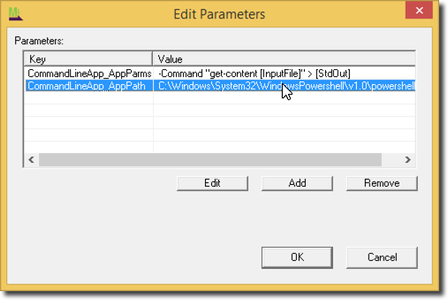
Building PowerShell Scripts for MOVEit Central
Your script should:
Have parameters to accept files
Use Write-Output to send to MOVEit's debug log
Determine success/failure based on custom exit codes
To execute your script:
Use a Command Line App process
Use [StdOut], [StdErr] and [InputFile]

Slide 13





Demo: Azure SQL DB/PowerShell/MOVEit

Slide 14
Resources
PowerShell Scripts
http://bit.ly/moveit_powershell
MOVEit Central Eval
http://www.ipswitchft.com/app/download/moveit-central/evaluation.aspx

